Slide 1
1 Thessalonians 2:1-12
a cd of this message will be available (free of charge) immediately following today’s service
a podcast will be available later in the week at calvaryokc.com
This Photo by Unknown Author is licensed under CC BY-SA

Slide 2
¹ For you yourselves know, brethren, that our coming to you was not in vain. ² But even after we had suffered before and were spitefully treated at Philippi, as you know, we were bold in our God to speak to you the gospel of God in much conflict. ³ For our exhortation did not come from error or uncleanness, nor was it in deceit.
⁴ But as we have been approved by God to be entrusted with the gospel, even so we speak, not as pleasing men, but God who tests our hearts.
1 Thessalonians 2:1-12

Slide 3
⁵ For neither at any time did we use flattering words, as you know, nor a cloak for covetousness—God is witness. ⁶ Nor did we seek glory from men, either from you or from others, when we might have made demands as apostles of Christ. ⁷ But we were gentle among you, just as a nursing mother cherishes her own children. ⁸ So, affectionately longing for you, we were well pleased to impart to you not only the gospel of God, but also our own lives, because you had become dear to us.
1 Thessalonians 2:1-12

Slide 4
⁹ For you remember, brethren, our labor and toil; for laboring night and day, that we might not be a burden to any of you, we preached to you the gospel of God.
¹⁰ You are witnesses, and God also, how devoutly and justly and blamelessly we behaved ourselves among you who believe; ¹¹ as you know how we exhorted, and comforted, and charged every one of you, as a father does his own children, ¹² that you would walk worthy of God who calls you into His own kingdom and glory.
1 Thessalonians 2:1-12

Slide 5
1 Thessalonians 2:1-12

Slide 6
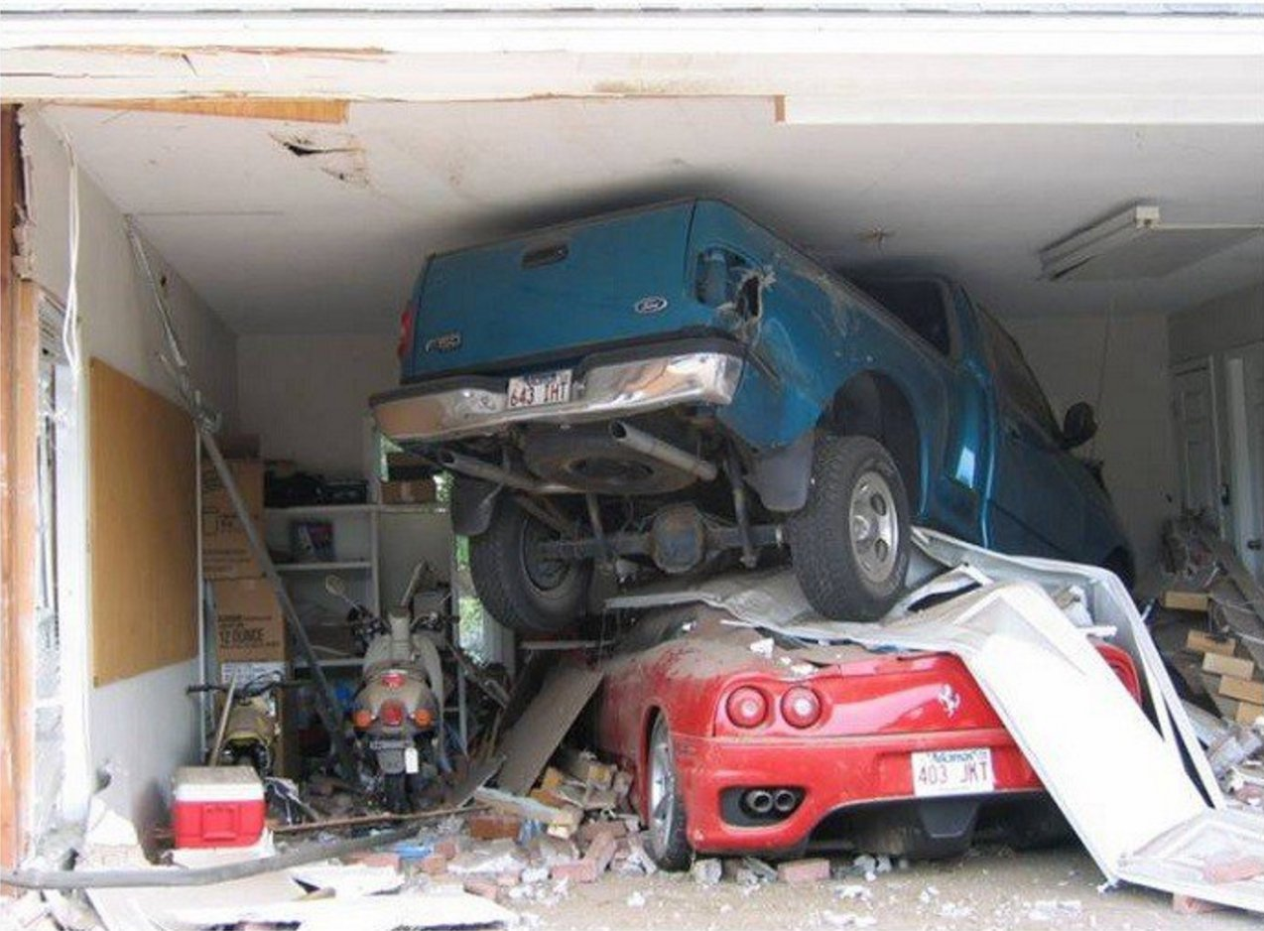
PS, Your girlfriend called for you
1 Thessalonians 2:1-12

Slide 7
1 Thessalonians 2:1-12

Slide 8
vain ~ noun form of kenoō ~ to make empty or to neutralize
Phil. 2:7 – but made Himself of no reputation, taking the form of a bondservant, and coming in the likeness of men.
was not ~ perfect tense – was not and is not in vain
1 Thessalonians 2:1-12

Slide 9
1 Thessalonians 2:1-12

Slide 10
conflict ~ agōn (agony)
WYSIWYG
hat
ou
ee
s
hat
ou
et
1 Thessalonians 2:1-12

Slide 11
1 Thessalonians 2:1-12

Slide 12
Sophists
Philosophers
philos (love)
philos (love) + sophos (wisdom)
Wise guys
Lovers of wisdom
1 Thessalonians 2:1-12

Slide 13
1 Thessalonians 2:1-12

Slide 14
1) It was not in deceit
deceit ~ verb form of the word for “decoy”
error ~ usually carries the idea of error leading to error
uncleanness ~ akatharsia – lustful, luxurious, profligate living
Pragmatist: If it works it must be good
Paul: If it’s true it must be good
1 Thessalonians 2:1-12

Slide 15
1 Thessalonians 2:1-12

Slide 16
1) It was not in deceit
2) Paul was not a man-pleaser
A. T. Robertson (1863-1934) ~ “Few temptations assail the preacher more strongly than this one to please men, even if God is not pleased … Nothing but experience will convince some preachers how fickle is popular favor and how often it is at the cost of failure to please God. And yet the preacher wishes to win men to Christ. It is all as subtle as it is deceptive.”
1 Thessalonians 2:1-12

Slide 17
1) It was not in deceit
2) Paul was not a man-pleaser
3) It was not with selfish desire
1 Thessalonians 2:1-12

Slide 18
1 Thessalonians 2:1-12

Slide 19
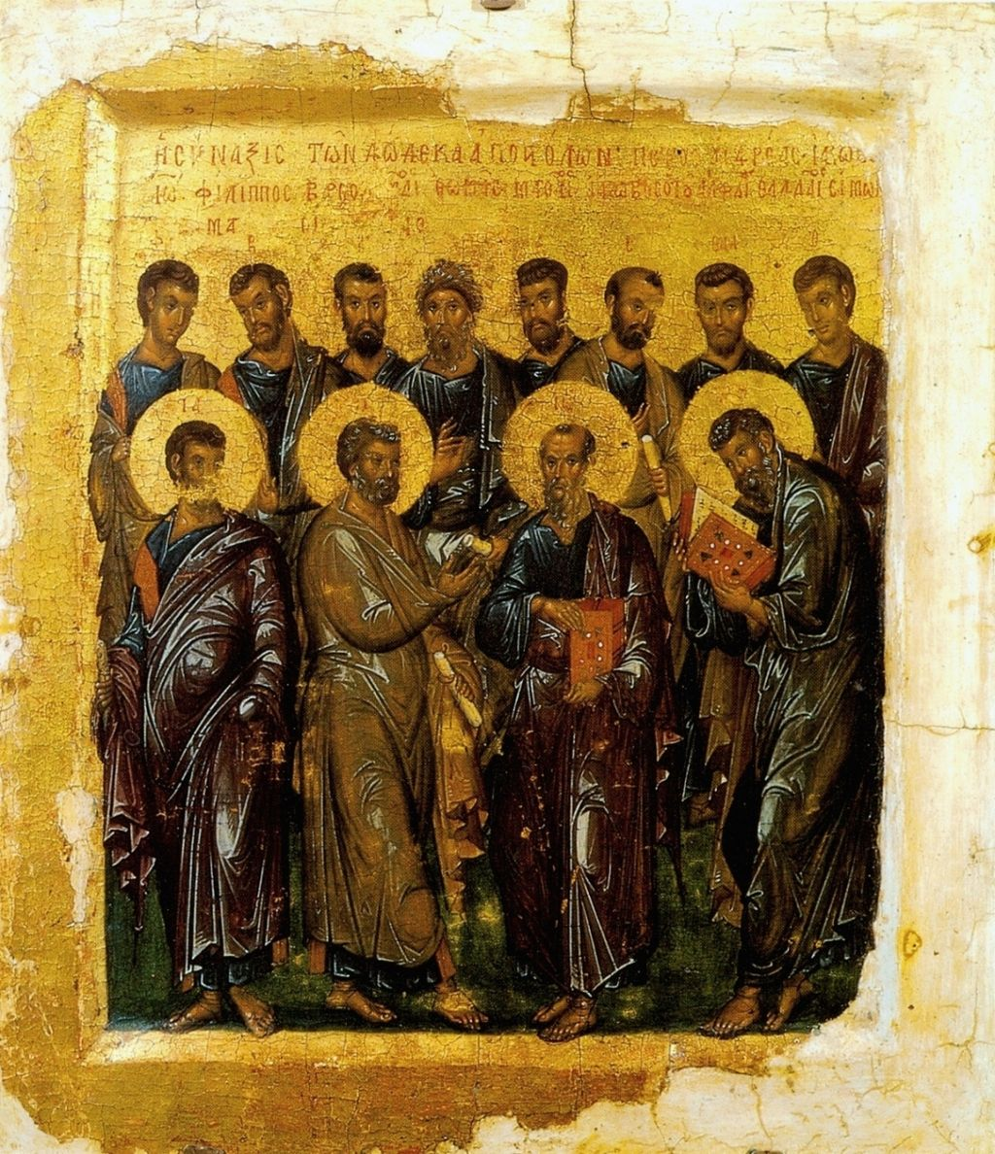
Chapter 11. Concerning Teachers, Apostles, and Prophets. Whosoever, therefore, comes and teaches you all these things that have been said before, receive him. But if the teacher himself turns and teaches another doctrine to the destruction of this, hear him not. But if he teaches so as to increase righteousness and the knowledge of the Lord, receive him as the Lord. But
concerning the apostles and prophets, act according to the decree of the Gospel. Let every apostle who comes to you be received as the Lord. But he shall not remain more than one day; or two days, if there's a need. But if he remains three days, he is a false prophet. And when the apostle goes away, let him take nothing but bread until he lodges. If he asks for money, he is a false prophet.
c. AD 100
“The Teaching”
The Didachē
1 Thessalonians 2:1-12

Slide 20
1) It was not in deceit
2) Paul was not a man-pleaser
3) It was not with selfish desire
4) It was not as a despot
Dwight Eisenhower ~ “It’s easier to pull a string than to push it.”
1 Thessalonians 2:1-12

Slide 21
1 Thessalonians 2:1-12

Slide 22
lives ~ KJV, souls – psuchē
1 Thessalonians 2:1-12

Slide 23
1 Thessalonians 2:1-12

Slide 24
devoutly ~ KJV, holily
1 Thessalonians 2:1-12

Slide 25
1 Thessalonians 2:1-12

